Slide 1
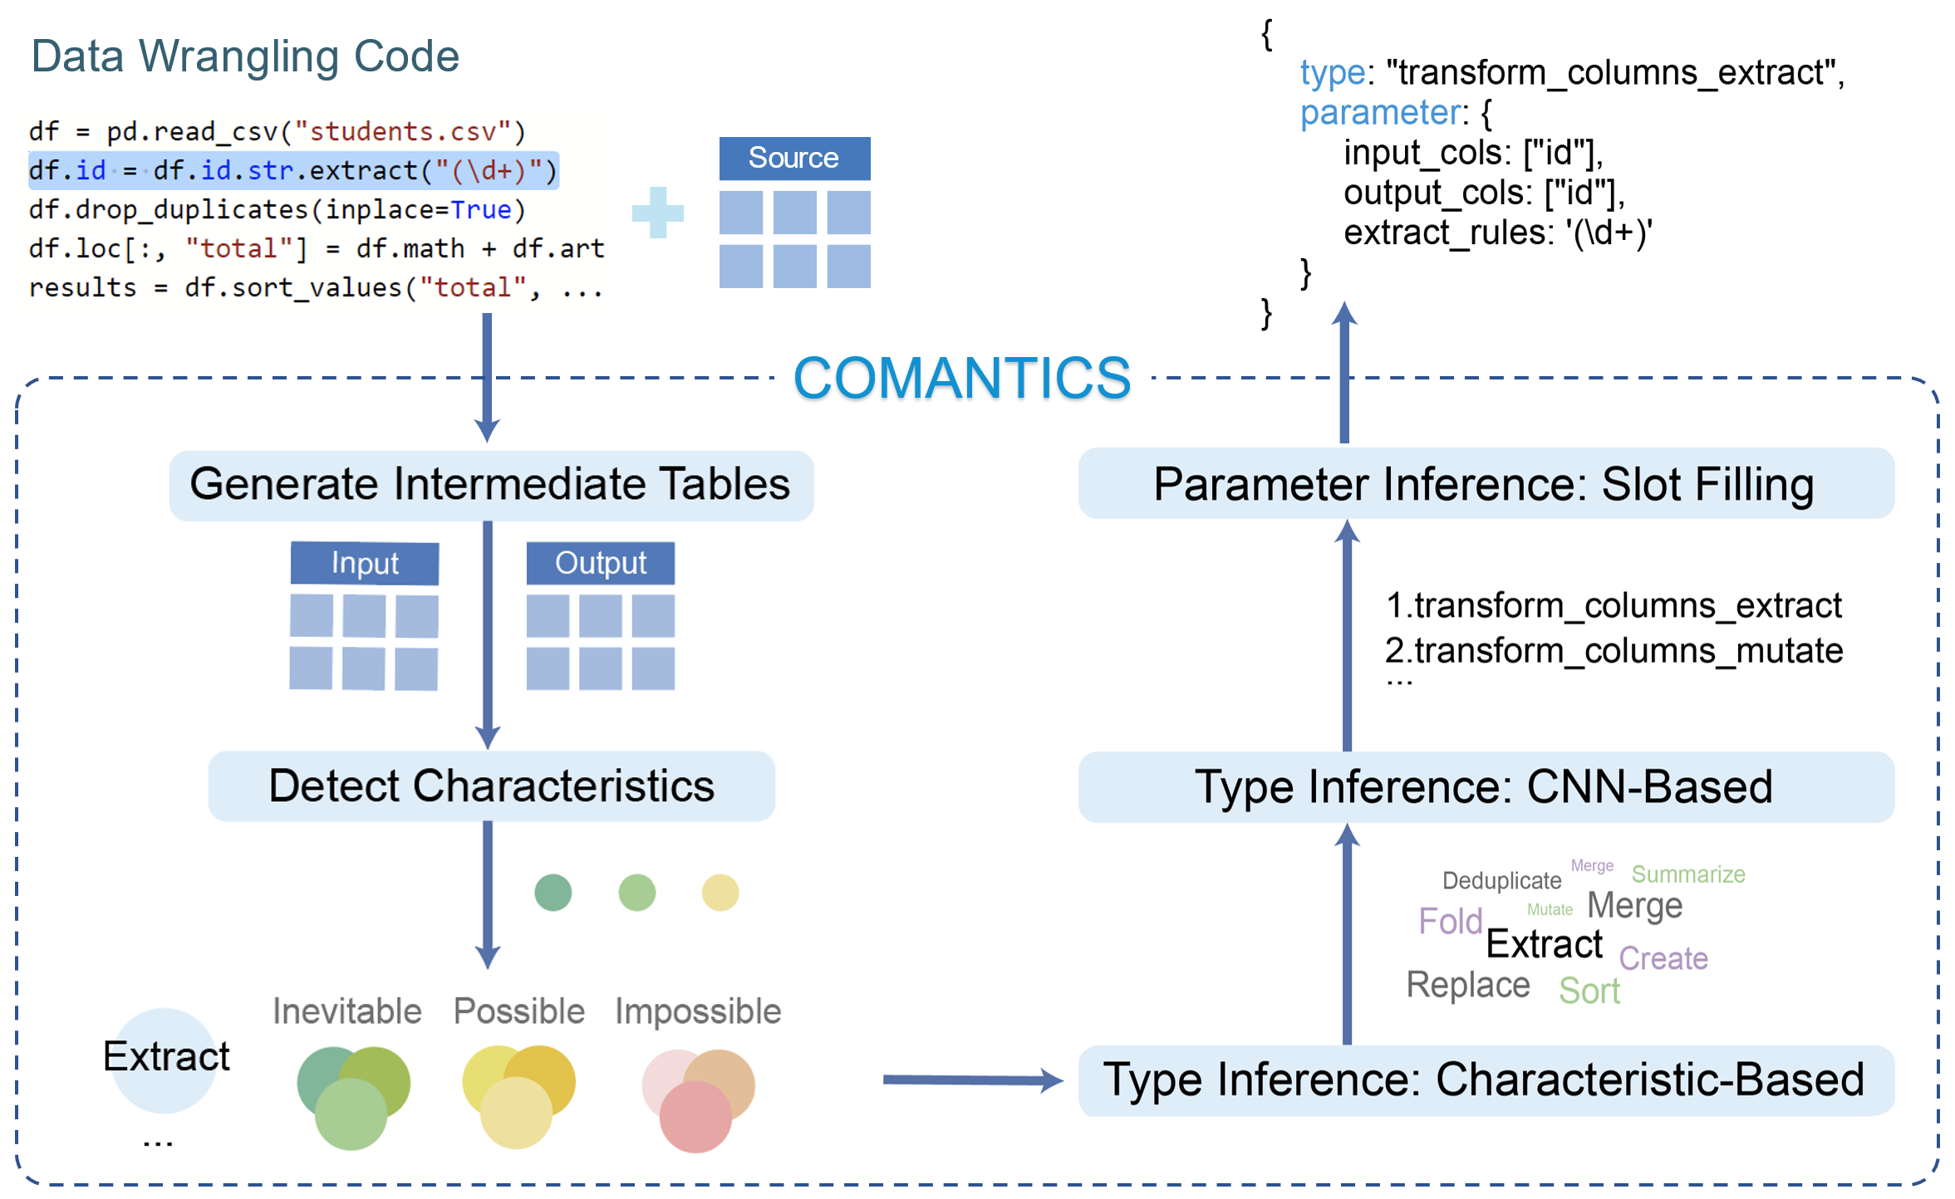







INTERACTIVE DATA GROUP
Revealing the Semantics of Data Wrangling Scripts With COMANTICS
Kai Xiong^{1, 2}
Zhongsu Luo^{3, 2}
Siwei Fu²
Yongheng Wang²
Mingliang Xu⁴
Yingcai Wu^{1, 2}
¹ State Key Lab of CAD&CG, Zhejiang University, Hangzhou, China
² Zhejiang Lab, Hangzhou, China
³ Zhejiang University of Technology, Hangzhou, China
⁴ School of Computer and Artificial Intelligence, Zhengzhou University, Zhengzhou, China
Notes:
Hello everyone, I am Kai from Zhejiang University.
Today I will introduce a latest paper from our group: Revealing the Semantics of Data Wrangling Scripts With COMANTICS.

Slide 2








Data Wrangling
Data Wrangling
clean
transform
enrich
expert
Data Workers
novice
Notes:
Data wrangling is a nontrivial activity of <click> cleaning, transforming, and enriching data into the desired form.
And it has become a routine <click> for data workers who carry out data analysis tasks <click> with different levels of expertise.
Data wrangling often involves a variety of data transformations

Slide 3

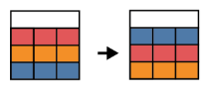
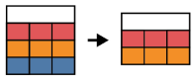
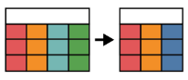

Data Transformation
Data Wrangling
Kasica et al. 2021.
A multi-table framework for data wrangling
Operation categories
Data object types
Create
Delete
Transform
Separate
Combine
Tables
Columns
Rows
clean
transform
enrich
15 high-level transformations
sort
filter rows
merge columns
S. Kasica, C. Berret, and T. Munzner. Table Scraps: An actionable framework for multi-table data wrangling from an artifact study of computational journalism. IEEE TVCG, 2021.
Notes:
Data wrangling often involves a variety of data transformations, such as sorting, filtering rows, and merging columns.
<click> Kasica et al. structured a multi-table framework for data wrangling, including 15 high-level transformations.
A commonplace method of wrangling data is

Slide 4








Semantics of Scripts
Data Wrangling
Semantics
How was the data changed?
clean
transform
enrich
debugging
reusing
maintaining
Notes:
A commonplace method of wrangling data is <click> writing scripts in various programming languages, <click> such as R and Python.
In this case, data workers usually seek to <click> understand the semantics of wrangling scripts in various scenarios, such as <click> code debugging, reusing, and maintaining.

Slide 5
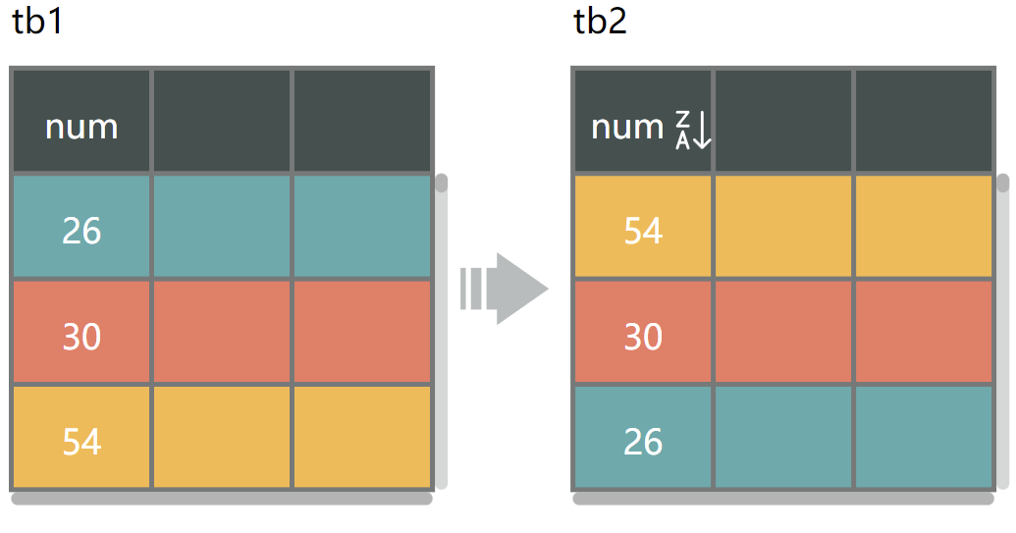
Semantics of Scripts
The semantics of wrangling code is the type of data transformation and its parameters.
Semantics
Transformation type: sort
tb2 = arrange(tb1, -num)
Parameters: {
Column: num
Input Table: tb1
Order: descending
Output Table: tb2
}
How was the data changed?
Notes:
Here we define the semantics of wrangling code as the type of data transformation and its parameters.
For example, <click> the semantics of this line of code refers to sorting the column num of the input table in descending order, and returning the output table.

Slide 6
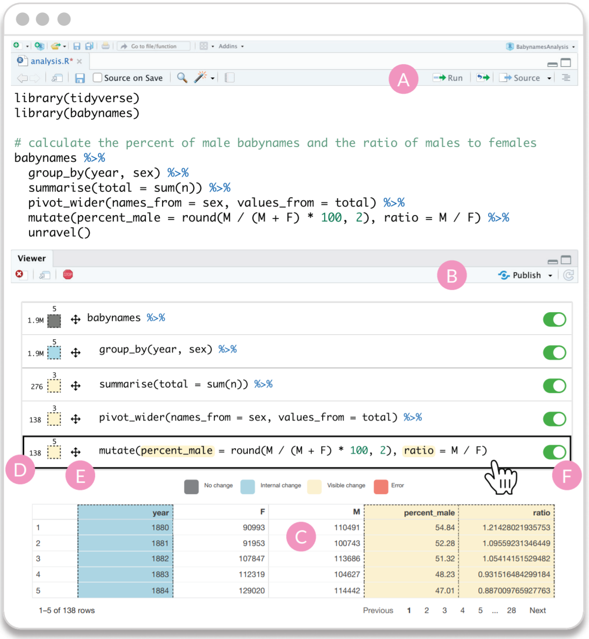
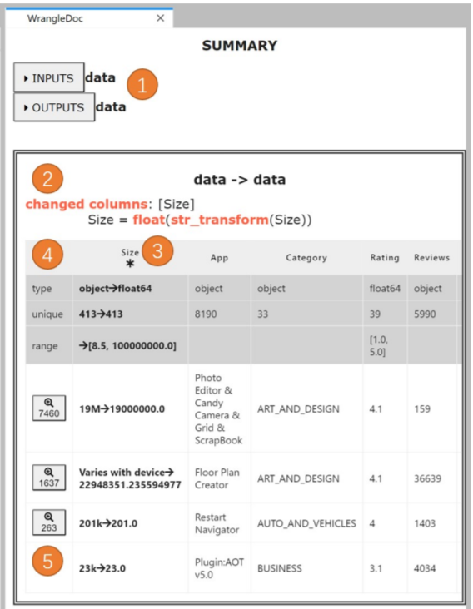
Program Understanding
Shrestha et al. 2021
Yang et al. 2021
Unravel
WrangleDoc
Cannot support inferring data transformations
Notes:
A body of prior work has been proposed to help data workers understand wrangling scripts.
Some debugging tools are useful for revealing changes in data tables.
But <click> they cannot support inferring data transformations.

Slide 7
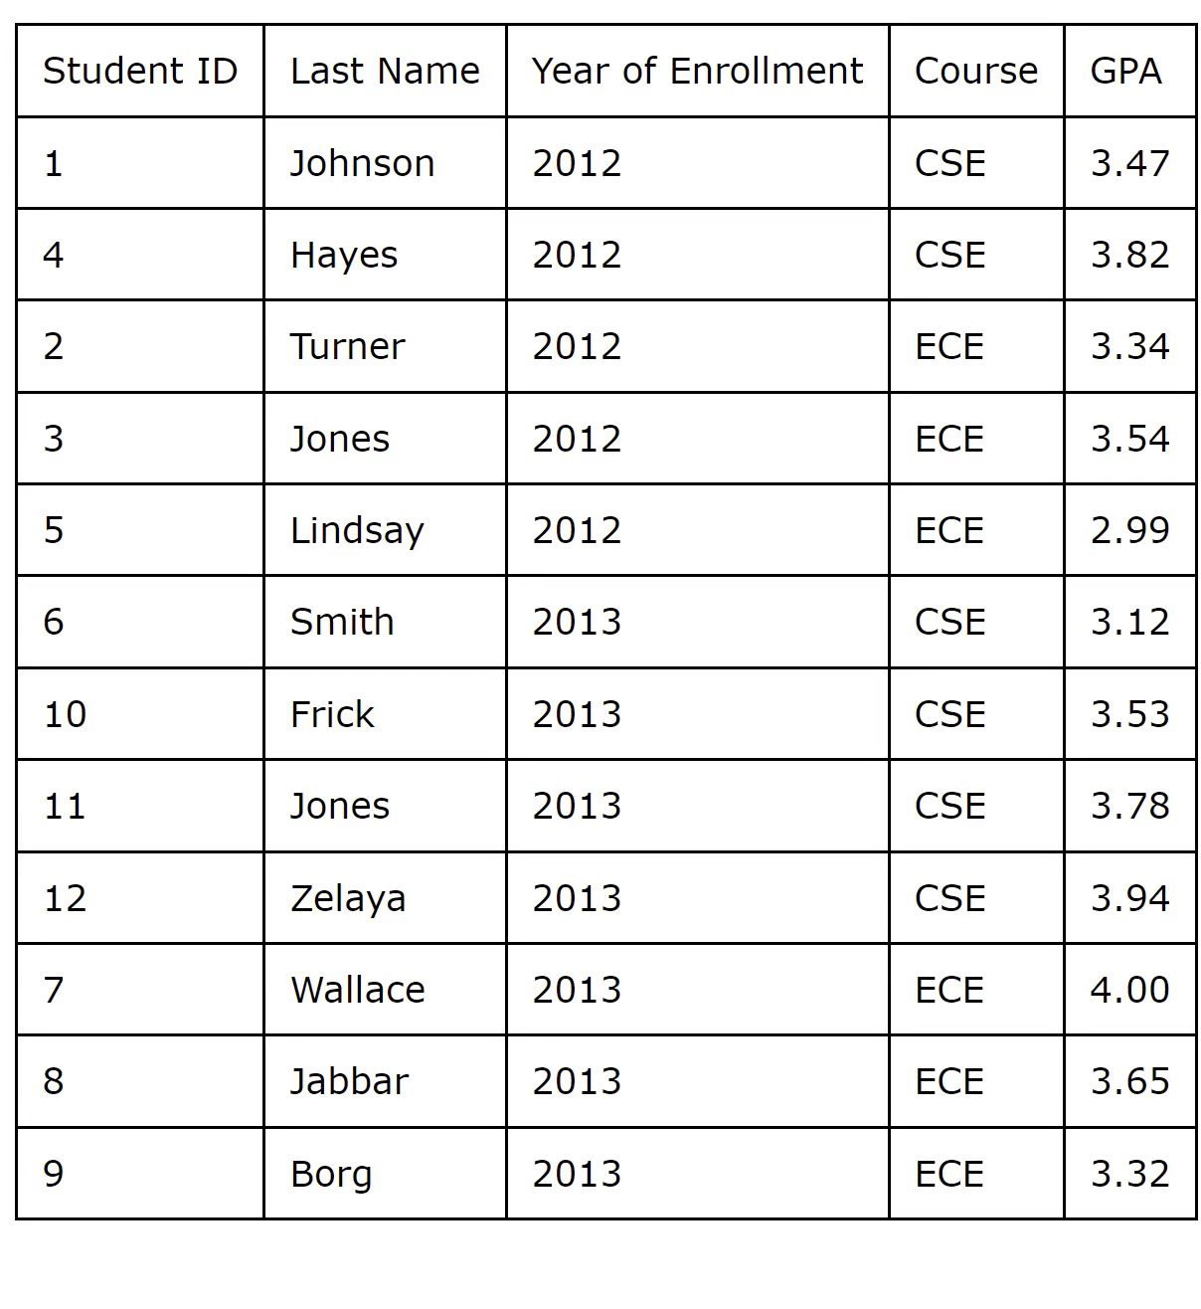
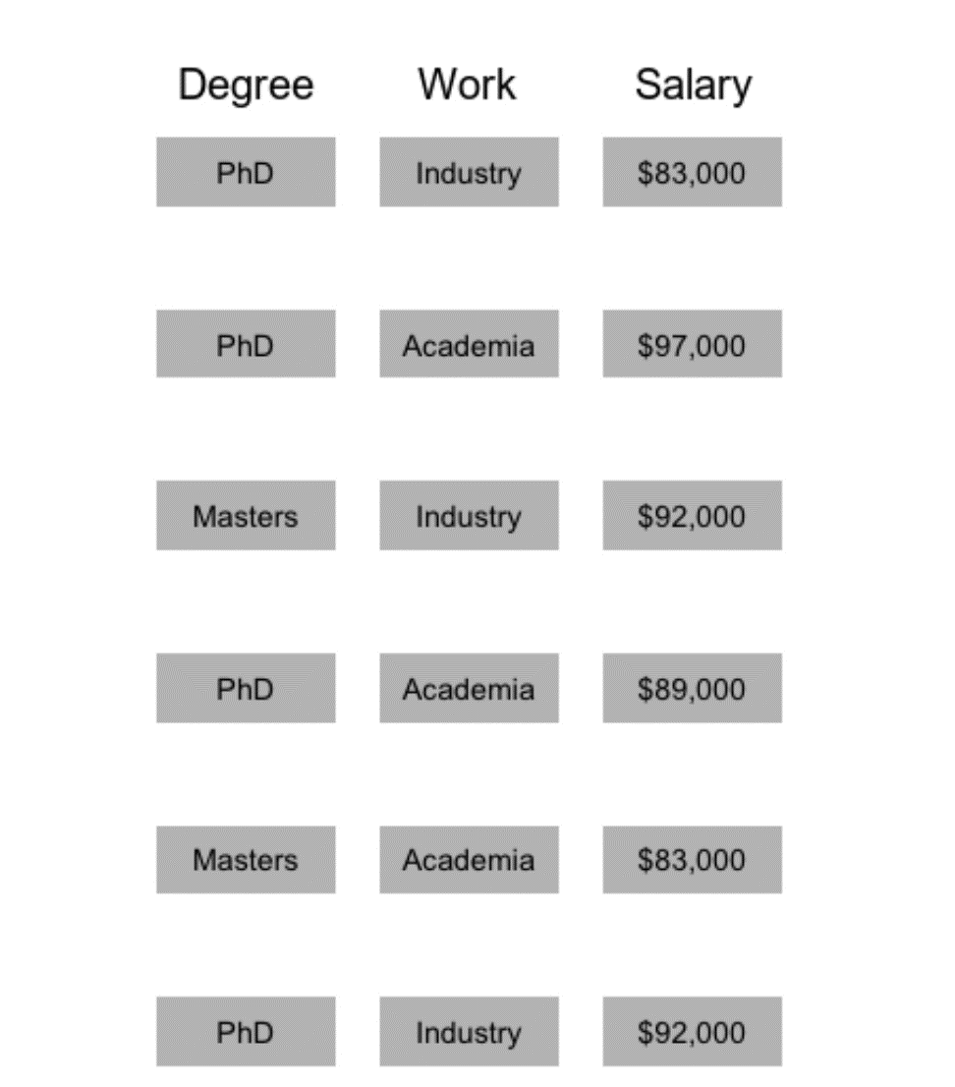
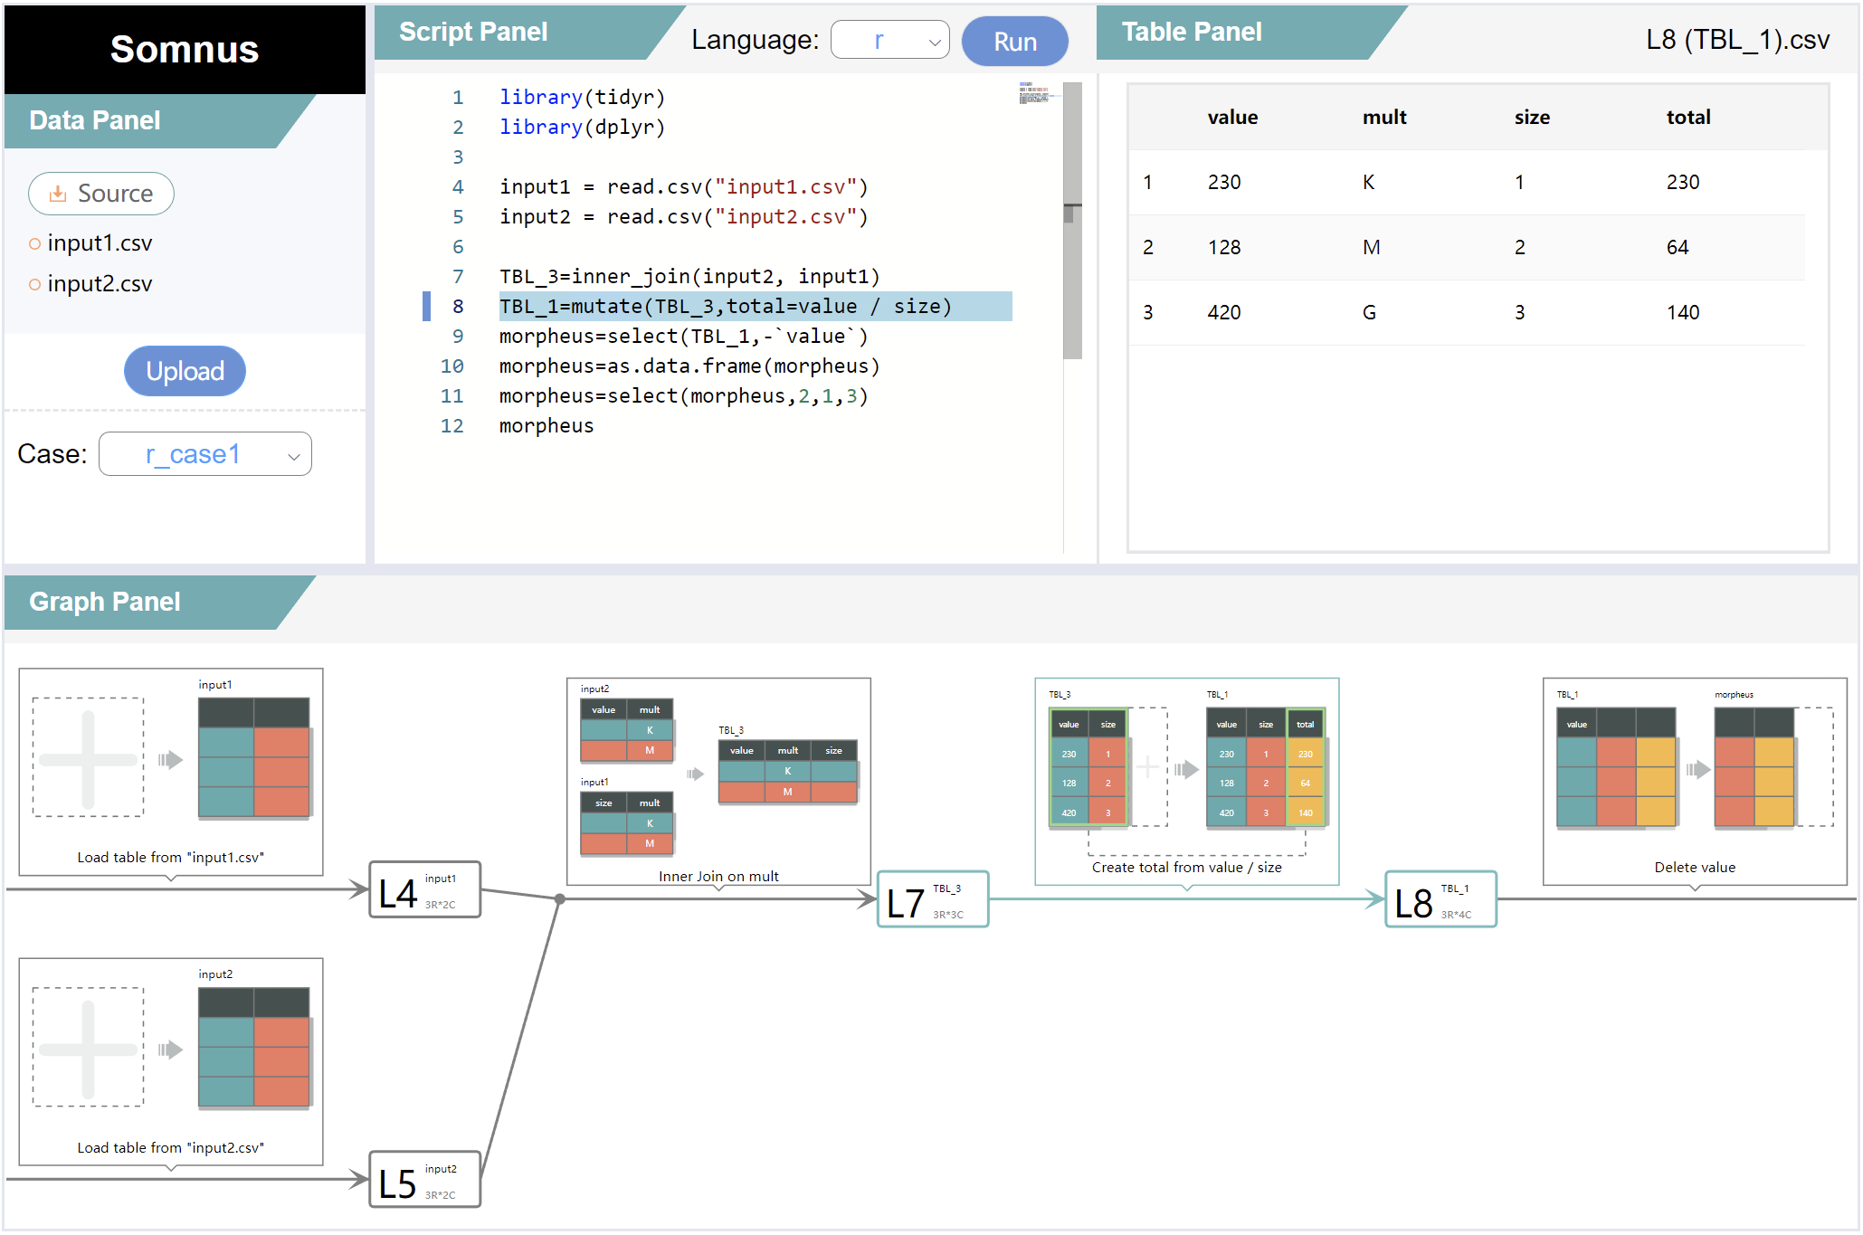
Program Understanding
Khan et al. 2017
Pu et al. 2021
Xiong et al. 2022
Data Tweening
Datamations
SOMNUS
Rely on hand-crafted rules, limited in generalizability and scalability
Notes:
Some tools are designed to visualize the semantics of data wrangling.
However, they <click> rely on hand-crafted rules to parse code, resulting in poor generalizability and scalability.

Slide 8
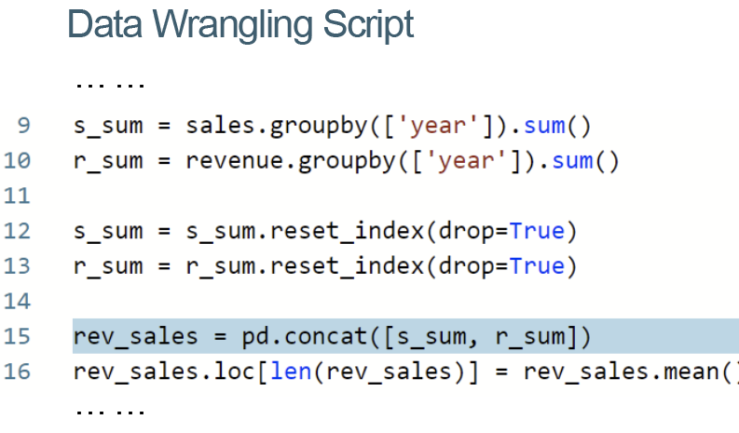
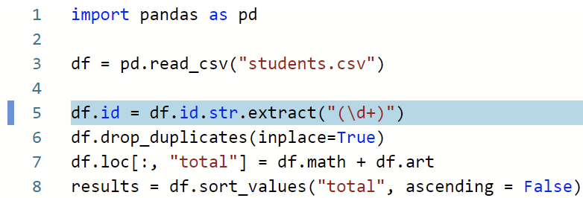
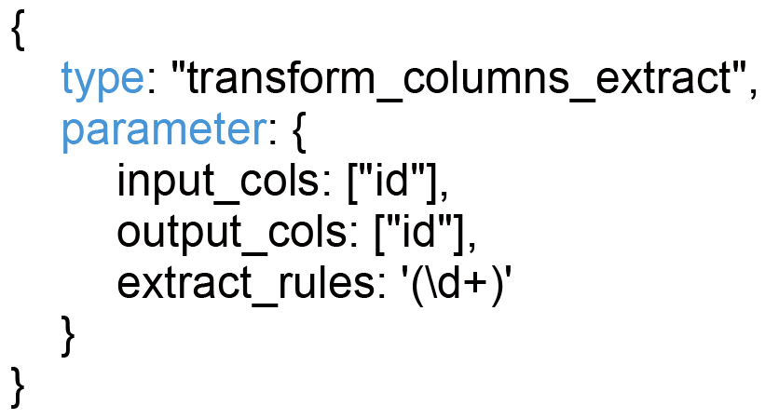

COMANTICS
Semantics
Notes:
In this work, we propose a pipeline, COMANTICS, to automatically reveal the semantics of data wrangling scripts by inferring the types of data transformations with their parameters.

Slide 9
Challenges
Scripting Language Level
Function Level
Parameter Level
Notes:
However, developing such a pipeline poses three levels of challenges.

Slide 10


Challenges
Scripting Language Level
Function Level
Parameter Level
Different scripting languages have diverse regulations in implementing data transformations
tb2 = arrange(tb1, -num)
tb2 = arrange(tb1, desc(num))
tb2 = tb1.sort_values(‘num’, ascending=False)
tb2 = tb1.sort_values(by=[‘num’], ascending=False)
Sort
Notes:
First, different scripting languages have diverse regulations in implementing data transformations.
For example, there are different ways to represent the descending order in different languages.

Slide 11
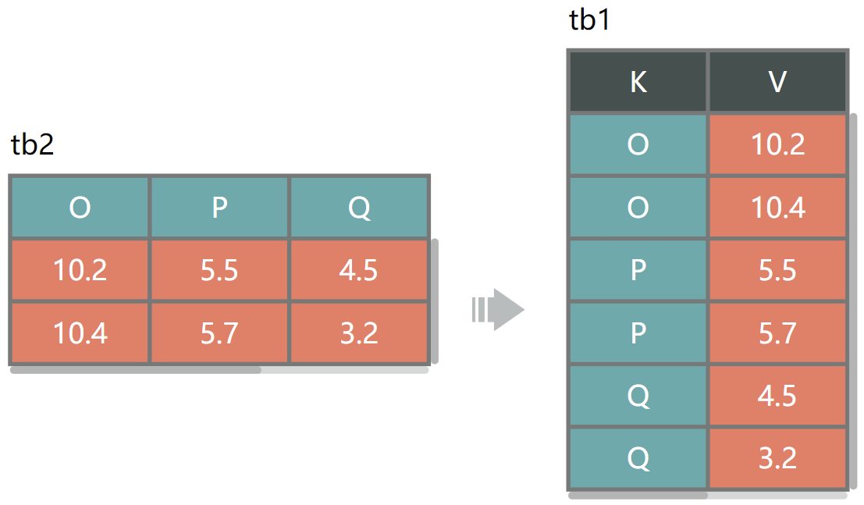

Challenges
Scripting Language Level
Function Level
Parameter Level
There are different functions to implement the same data transformation
tb2 = gather(tb1, K, V, -`ID`, -`T`)
tb2 = pivot_longer(tb1, O:Q, names_to=‘K’, values_to=‘V’)
Fold
Notes:
Second, in one language, there are different functions to implement the same data transformation.

Slide 12
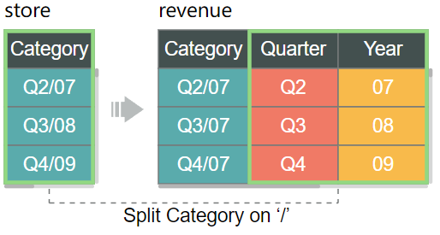
Challenges
Scripting Language Level
Function Level
Parameter Level
Functions may omit important parameters for simplicity
revenue = separate(store, Category, c(“Quarter”, “Year”), sep=“/”)
Split
Notes:
Third, some functions may omit important parameters for simplicity.

Slide 13
Challenges
Scripting Language Level
Function Level
Parameter Level
Different scripting languages have diverse regulations in implementing data transformations
There are different functions to implement the same data transformation
Functions may omit important parameters for simplicity
Notes:
Those challenges hinder novice data workers from understanding the semantics of data wrangling scripts.

Slide 14
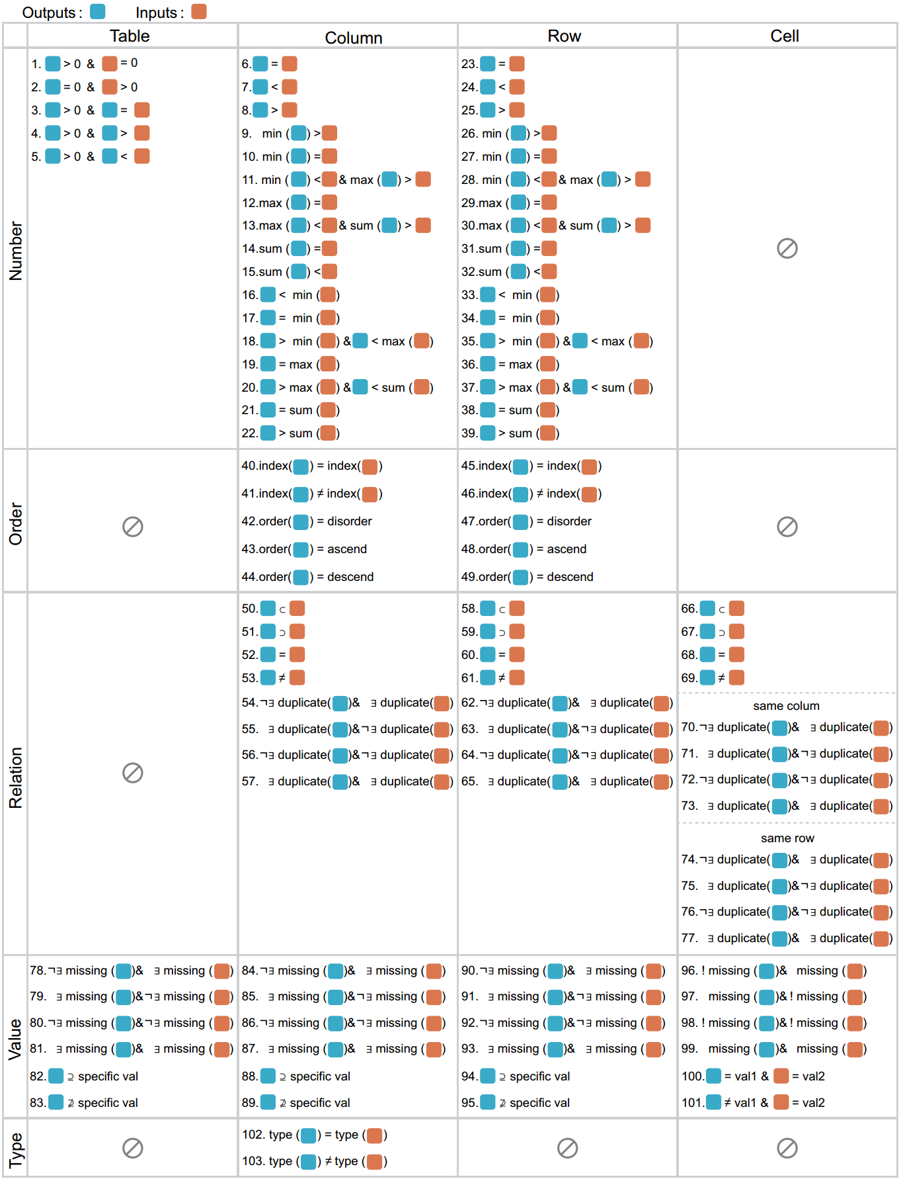




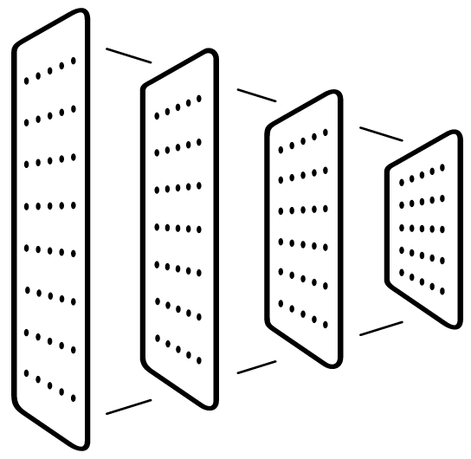


Our Solution
Qualitative research
A design space of table changes
Infer transformation candidates
Gender | Age
Male | 23
Female
Male | 31
Gender | Age
Male | 23
Male | 31
1
Filter Rows Where Gender is Male
Remove Rows with Missing Values
2
Machine learning
A CNN model
Resolve ambiguities
1
Filter Rows Where Gender is Male
Remove Rows with Missing Values
2
Notes:
To address these challenges, we blend qualitative research and machine learning techniques.
Specifically, <click> we apply a qualitative method to characterize a design space of table changes to infer transformation candidates, <click> and leverage a CNN model to resolve ambiguities.

Slide 15

Observation
Differences between input and output tables can reveal the transformation type
Input
Output
High-level transformation
Low-level operation
Gender | Age
Male | 23
Female
Male | 31
Gender | Age
Male | 23
Male | 31
Create Columns
Filter:
Filter Rows Where Gender is Male
1
Create Rows
Delete Rows
DropNa:
Remove Rows with Missing Values
Delete Rows
2
Combine Columns
Observation
Design Space
Mapping
COMANTICS
Notes:
We observe that differences between input and output tables can reveal the transformation type to some extent.
<click> In this example, we find <click> the second row is deleted, while the others remain unchanged, thus the transformation belongs to <click> Delete Rows.
Further, if all <click> deleted rows contain missing values while the remaining do not, the transformation type is likely <click> to be DropNa.

Slide 16

Observation
Differences between input and output tables can reveal the transformation type
Input
Output
High-level transformation
Low-level operation
Gender | Age
Male | 23
Female
Male | 31
 | 26
Gender | Age
Male | 23
Male | 31
Create Columns
Filter:
Filter Rows Where Gender is Male
1
Create Rows
DropNa:
Remove Rows with Missing Values
Delete Rows
DropNa:
Remove Rows with Missing Values
2
2
Combine Columns
Observation
Design Space
Mapping
COMANTICS
Notes:
Further, if all deleted rows contain missing values, the transformation type is likely <click> to be DropNa.

Slide 17
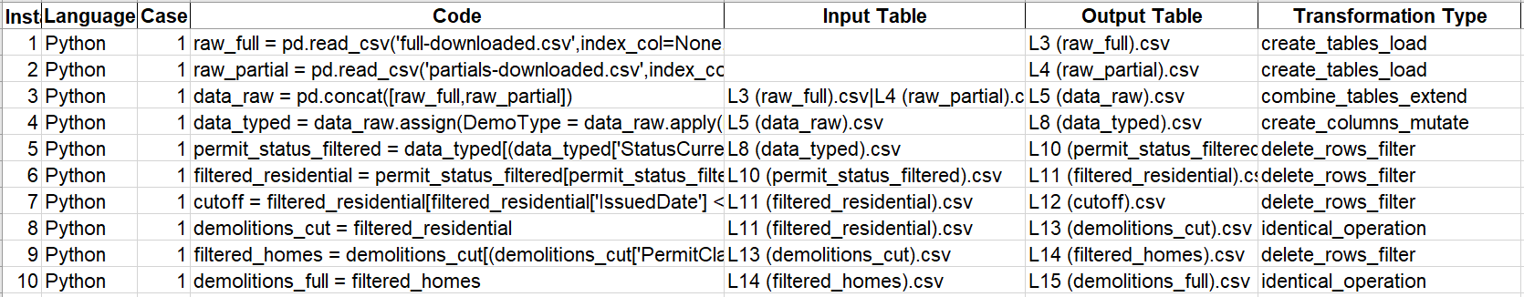

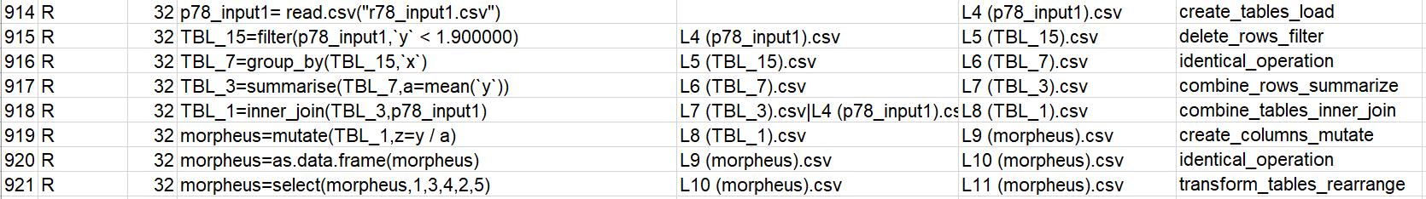
Design Space for Table Changes
For different transformations, what changes can be made to tables?
921 lines of wrangling code
Observation
Design Space
Mapping
COMANTICS
Notes:
Motivated by the observation, we attempt to explore what changes can be made to tables for different transformations.
To this end, we first <click> collect a real-world dataset including 921 lines of wrangling code, <click> where each is annotated with its input and output tables and a transformation type.
Here the transformation type is a combination of one high-level transformation and one low-level operation.

Slide 18
Design Space for Table Changes
For different transformations, what changes can be made to tables?
High-level transformation
Low-level operation
Transformation type
Create Columns
Filter
delete_rows_filter
Create Rows
DropNa
Delete Rows
Deduplicate
Combine Columns
Slice Keep
Observation
Design Space
Mapping
COMANTICS
Notes:
Here the transformation type is a combination of one high-level transformation and one low-level operation.
We then record the differences between input and output tables and use the qualitative method of open and axial coding on these differences.

Slide 19


Design Space for Table Changes
For different transformations, what changes can be made to tables?
table differences
record
open and
axial coding
the space of table changes
Observation
Design Space
Mapping
COMANTICS
Notes:
We then record the differences between input and output tables and use the qualitative method of open and axial coding on these differences.
Finally, <click> we develop a design space for table changes.
The design space comprises 4 types of data objects

Slide 20
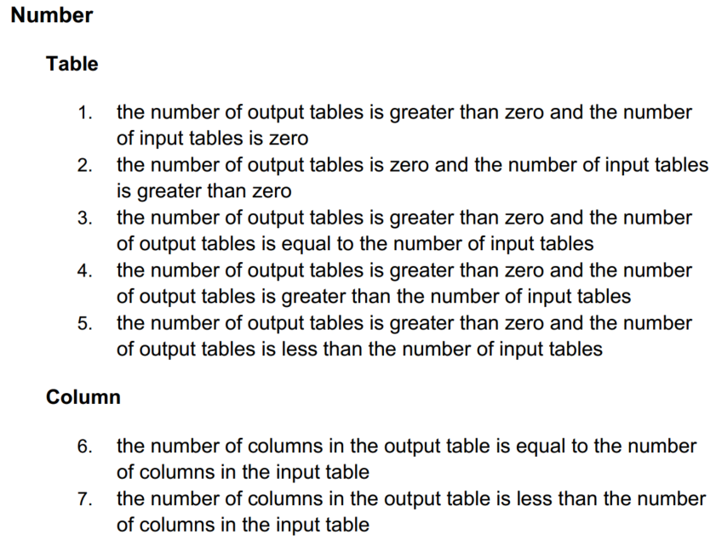
Design Space for Table Changes
2 dimensions
103 characteristics
C₁ — C₁₀₃
Types of data objects
Tables
Columns
Rows
Cells
Properties of data changes
Number
Order
Relation
Value
Type
Observation
Design Space
Mapping
COMANTICS
Notes:
The design space comprises 4 types of data objects and 5 properties of data changes, <click> totaling 103 characteristics to describe table differences.
To utilize table differences for semantics inference

Slide 21
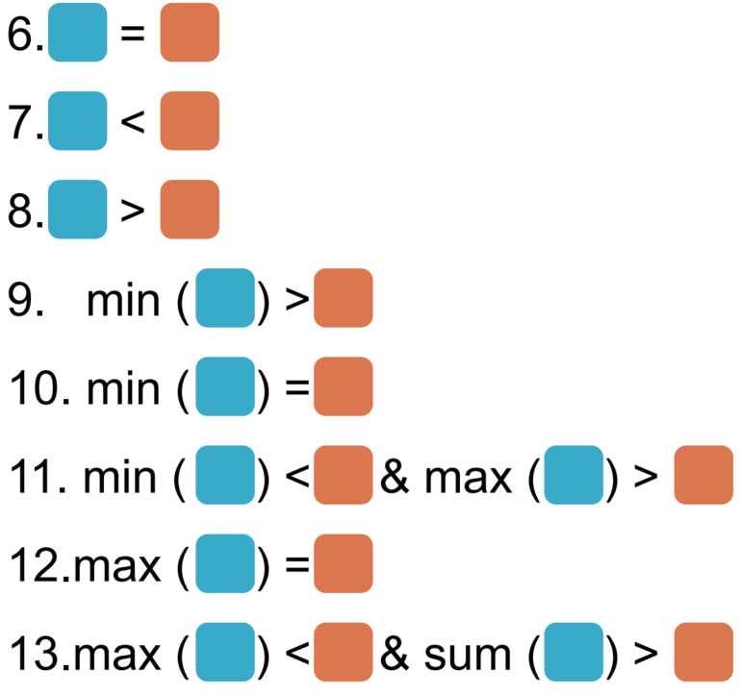

Build a Mapping
Transformations
Characteristics
create_columns_mutate
delete_rows_filter
delete_columns_select_keep
combine_rows_summarize
transform_columns_rename
transform_columns_mutate
transform_tables_sort
transform_columns_replace
Output
Input
Observation
Design Space
Mapping
COMANTICS
Notes:
To utilize table differences for semantics inference, we establish a mapping between transformations and characteristics.
For each transformation, we categorize characteristics into three groups.

Slide 22

Build a Mapping
Will the characteristic appear after performing a transformation?
Transformations
Inevitable
Impossible
Possible
create_columns_mutate
delete_rows_filter
delete_columns_select_keep
combine_rows_summarize
transform_columns_rename
transform_columns_mutate
transform_tables_sort
transform_columns_replace
C₁ , C₃
C₂ , C₅
C₃ , C₅
C₆ , C₉
C₁ , C₇
C₂ , C₈
C₂ , …
C₃ , …
C₁ , …
Observation
Design Space
Mapping
COMANTICS
Notes:
For each transformation, we categorize characteristics into three groups. <click> After performing a transformation, inevitable characteristics will <click> definitely exist in table changes, while impossible characteristics <click> are the inverse.
Possible characteristics <click> are those that may or may not appear.

Slide 23

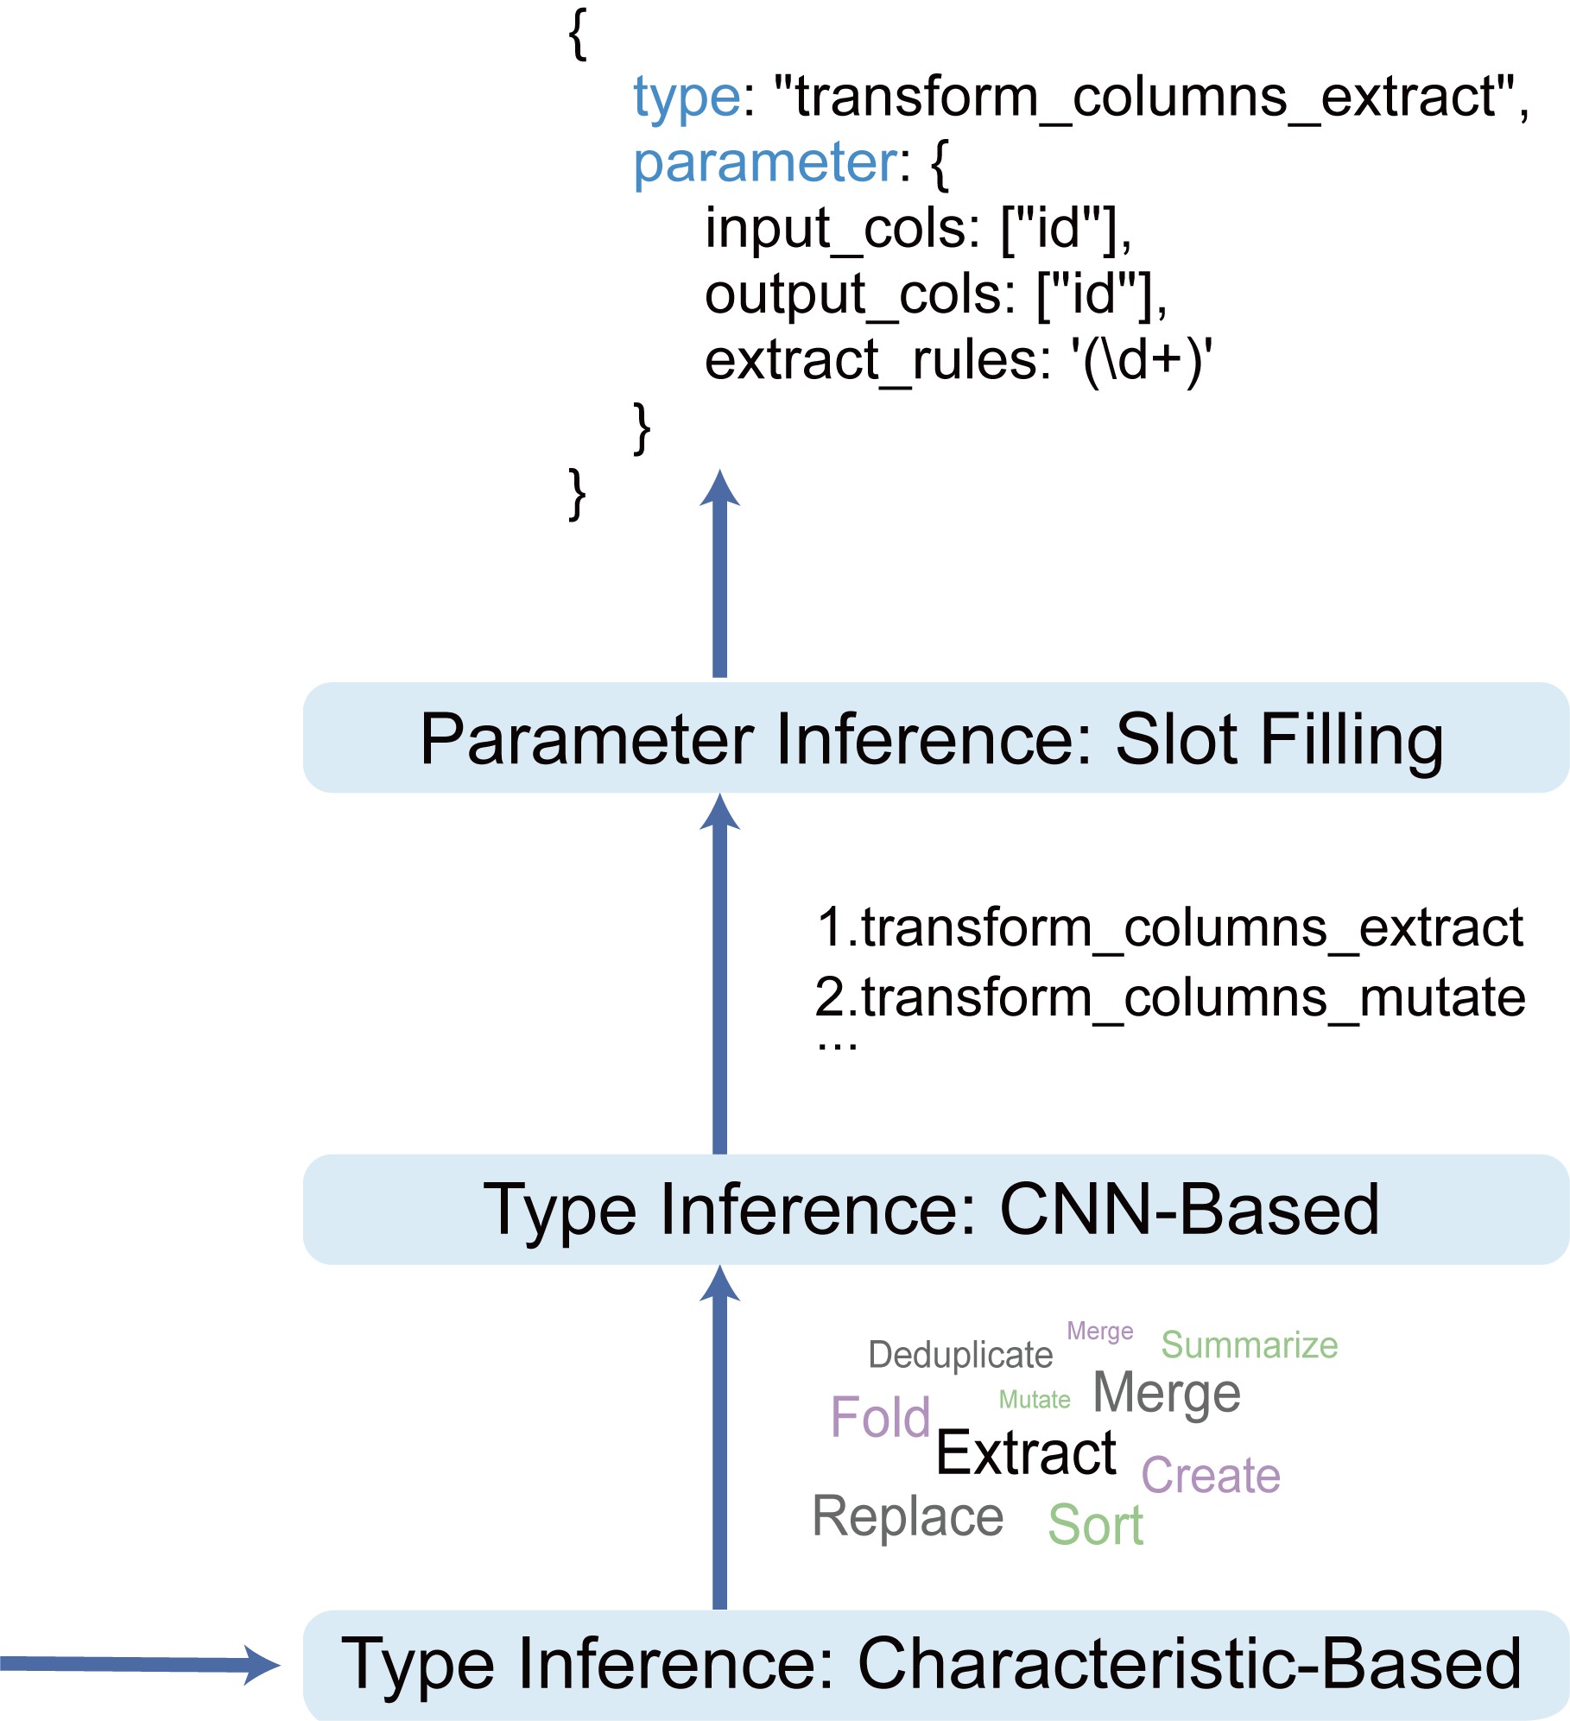
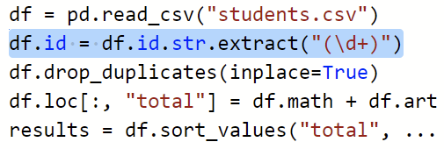
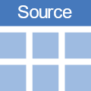

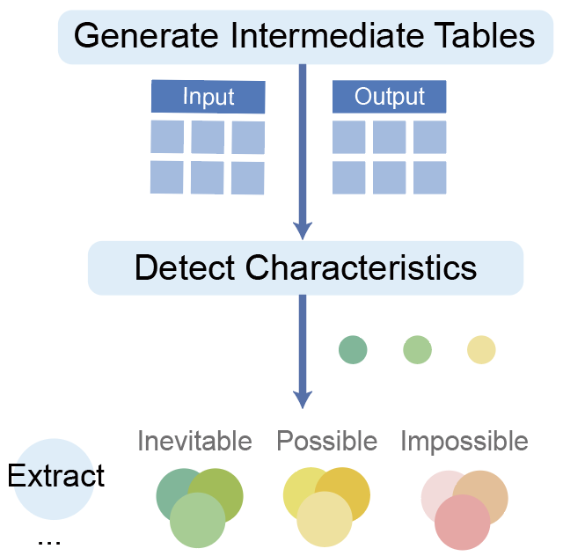
COMANTICS Overview
Notes:
After that, we develop COMANTICS, a three-step pipeline to automatically detect the semantics of wrangling scripts.

Slide 24
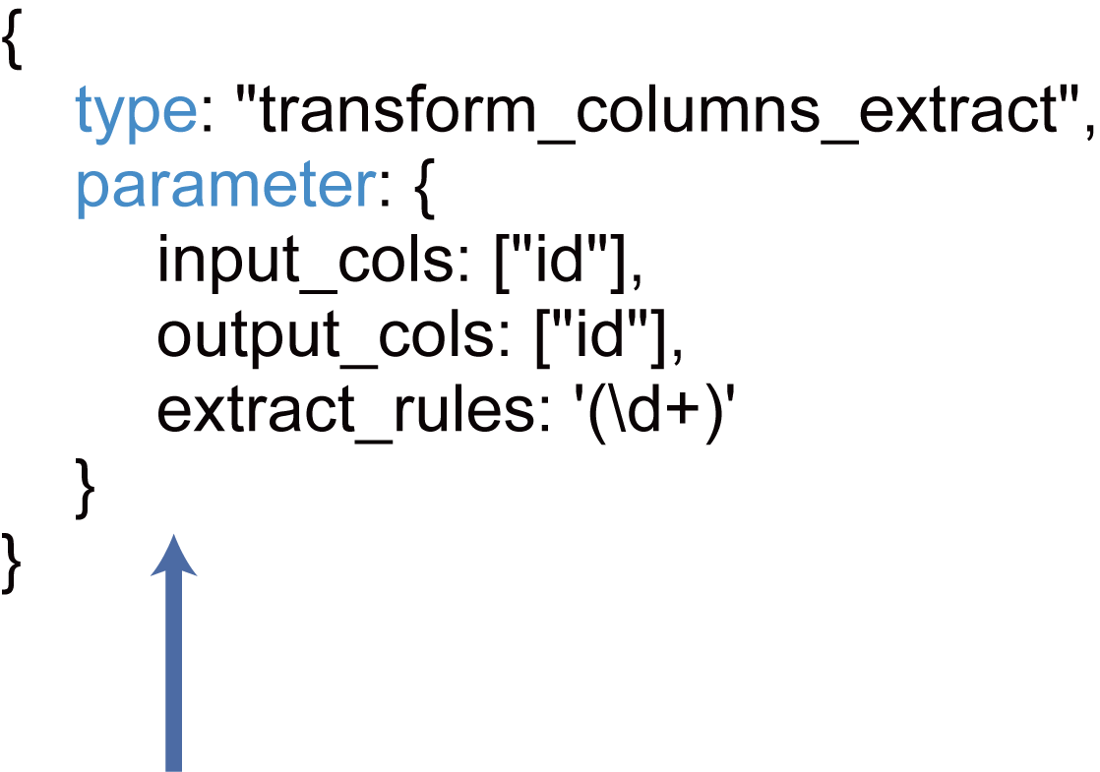
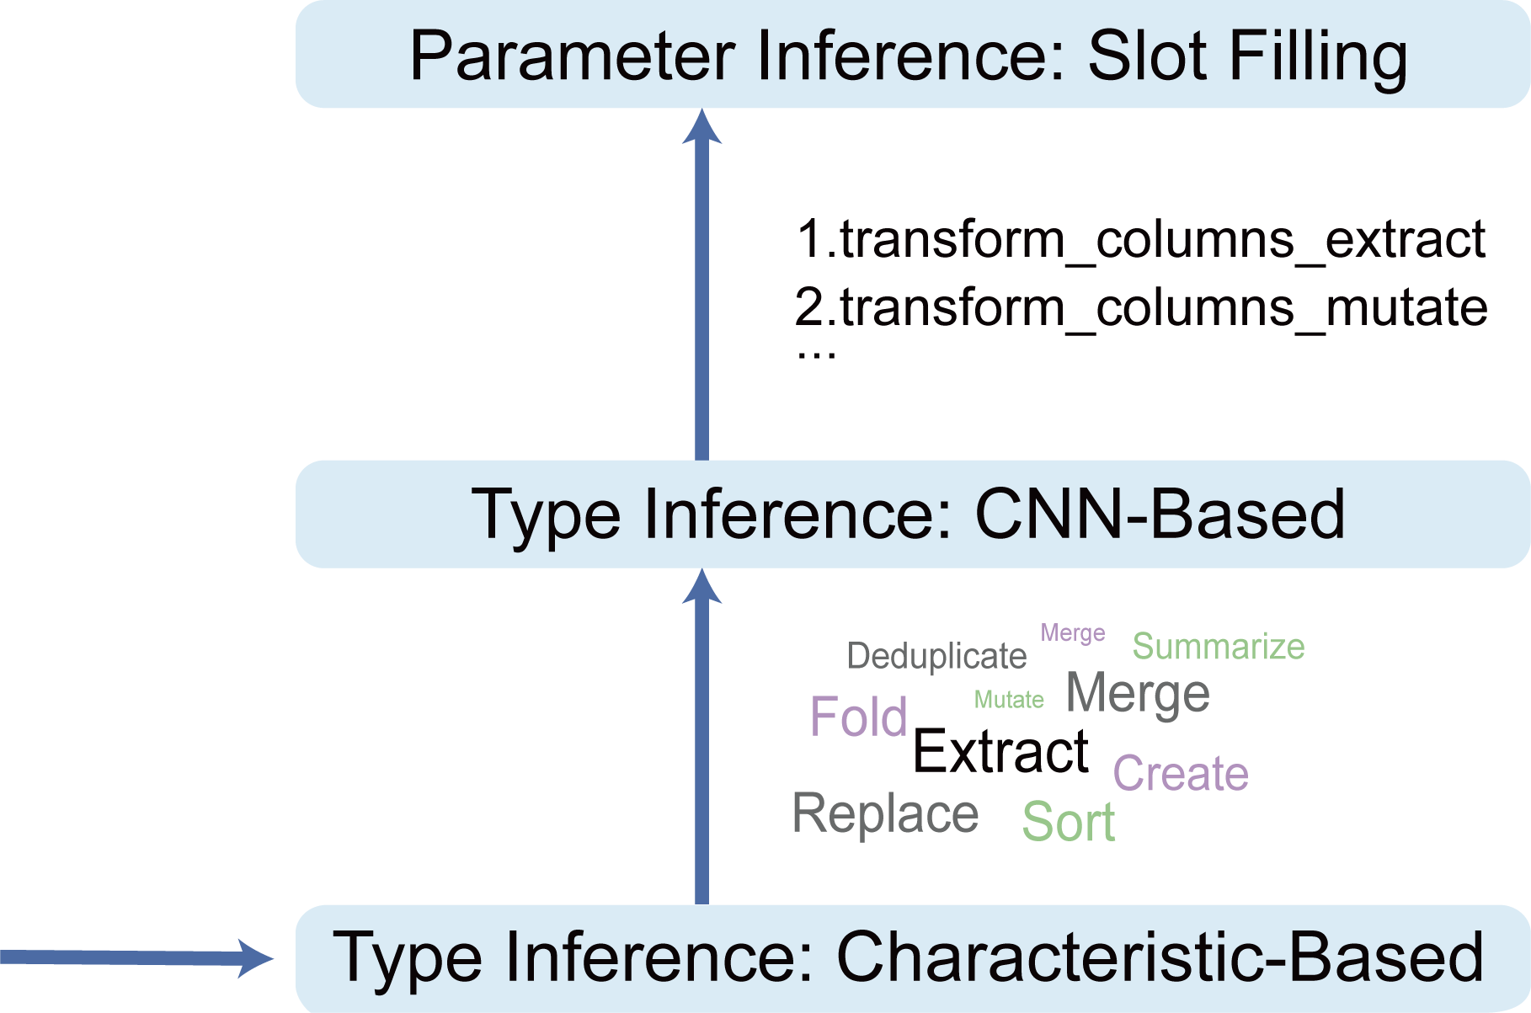
COMANTICS Overview
Data Processing
Notes:
COMANTICS first <click> generates intermediate input and output tables for each code and detects changes between them.
Then, <click> it identifies the transformation type through two components.
Last, <click> it infers parameters for the transformation.

Slide 25
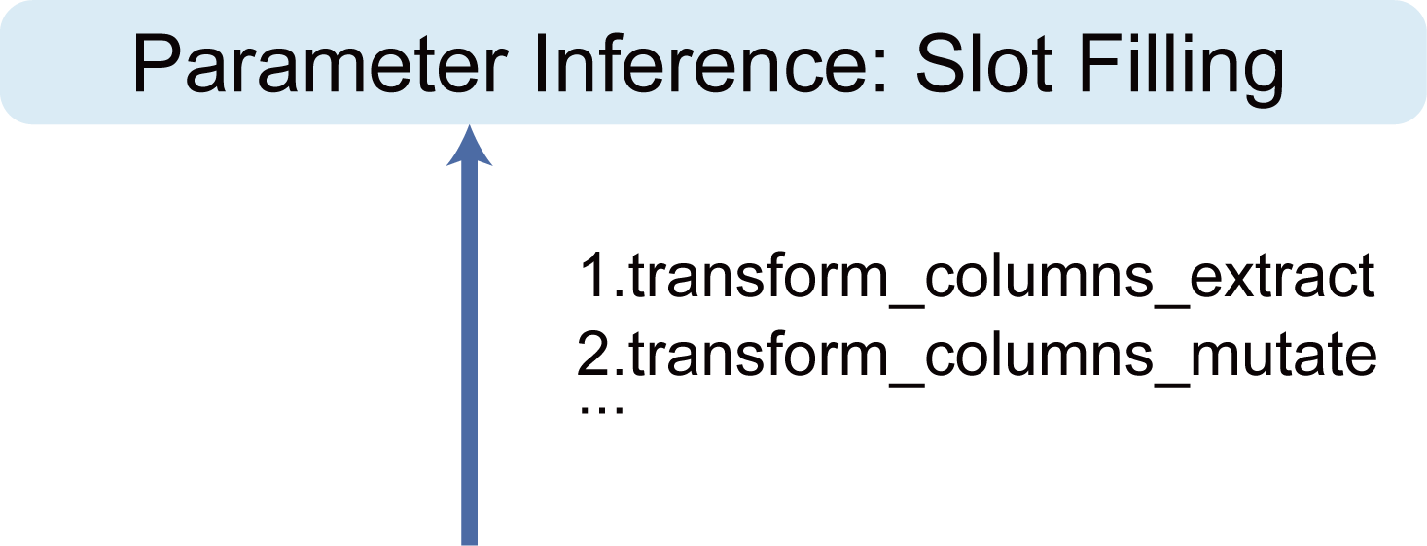
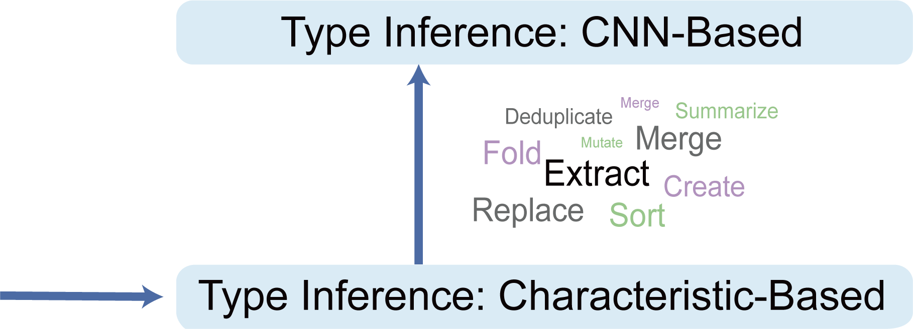
COMANTICS Overview
Data Processing
Type Inference
Notes:
COMANTICS first <click> generates intermediate input and output tables for each code and detects changes between them.
Then, <click> it identifies the transformation type through two components.
Last, <click> it infers parameters for the transformation.

Slide 26
COMANTICS Overview
Data Processing
Type Inference
Parameter Inference
Notes:
COMANTICS first <click> generates intermediate input and output tables for each code and detects changes between them.
Then, <click> it identifies the transformation type through two components.
Last, <click> it infers parameters for the transformation.
Let's see the pipeline in detail.
Since table changes are conducive to identifying the transformation type

Slide 27



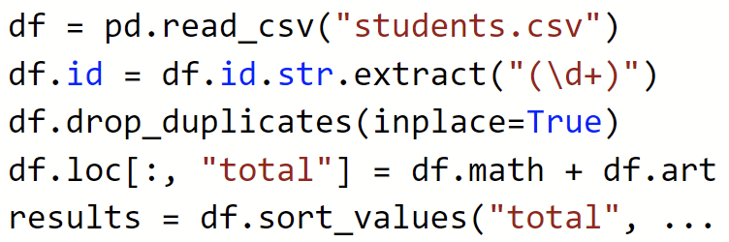
COMANTICS
Data Processing
Intermediate Tables
Generate Tables
Input
Output
Type Inference
Parameter Inference
Notes:
Since table changes are conducive to identifying the transformation type, <click> we first execute the wrangling script on the given source table <click> to obtain intermediate input and output tables for each line of code.
Then, we detect table changes based on the design space for each pair of input and output tables, and generate a set of characteristics.

Slide 28

COMANTICS
Data Processing
Intermediate Tables
Characteristic Set
Generate Tables
Input
Output
Detect Characteristics
C₂ , C₃ , C₅ , …
Type Inference
C₄ , C₁₆ , C₂₃ , …
C₆ , C₃₆ , C₄₈ , …
Parameter Inference
Notes:
Then, we detect table changes based on the design space for each pair of input and output tables, and generate a set of characteristics.
In the second step, we first use a characteristic-based component

Slide 29
COMANTICS
Data Processing
Characteristic Set
Two Strategies: filter out transformations whose
inevitable set is not a subset of the characteristic set
impossible set intersects the characteristic set
Generate Tables
Detect Characteristics
C₂ , C₃ , C₅ , …
Type Inference
C₄ , C₁₆ , C₂₃ , …
Characteristic-Based
C₆ , C₃₆ , C₄₈ , …
Parameter Inference
Notes:
In the second step, we first use a characteristic-based component to infer the transformation type, which involves <click> two strategies.
Take the <click> first characteristic set as an example

Slide 30

COMANTICS
Data Processing
Characteristic Set
Two Strategies: filter out transformations whose
inevitable set is not a subset of the characteristic set
impossible set intersects the characteristic set
Generate Tables
Detect Characteristics
C₂ , C₃ , C₅ , …
Type Inference
C₄ , C₁₆ , C₂₃ , …
Mapping
Transformation | Inevitable | Impossible | Possible
T₁ | C₁, C₃ | C₆, C₉ | C₂, …
T₂ | C₂, C₅ | C₁, C₇ | C₃, …
T₃ | C₃, C₅ | C₂, C₈ | C₁, …
… | … | … | …
Characteristic-Based
C₆ , C₃₆ , C₄₈ , …
Parameter Inference
Notes:
In the second step, we first use a characteristic-based component to infer the transformation type, which involves two strategies.
Take the <click> first characteristic set as an example, <click> C1 is an inevitable characteristic of T1, but it is not in the current characteristic set, so we <click> filter out T1.
<click> As for T3, C2 is impossible but in the set, so we <click> exclude T3.

Slide 31
COMANTICS
Data Processing
Characteristic Set
Two Strategies: filter out transformations whose
inevitable set is not a subset of the characteristic set
impossible set intersects the characteristic set
Generate Tables
Detect Characteristics
C₂ , C₃ , C₅ , …
Type Inference
C₄ , C₁₆ , C₂₃ , …
Mapping
Transformation | Inevitable | Impossible | Possible
T₁ | C₁, C₃ | C₆, C₉ | C₂, …
T₂ | C₂, C₅ | C₁, C₇ | C₃, …
T₃ | C₃, C₅ | C₂, C₈ | C₁, …
… | … | … | …
Characteristic-Based
Strategy 1
C₆ , C₃₆ , C₄₈ , …
Parameter Inference
Notes:
In the second step, we first use a characteristic-based component to infer the transformation type, which involves two strategies.
Take the <click> first characteristic set as an example, <click> C1 is an inevitable characteristic of T1, but it is not in the current characteristic set, so we <click> filter out T1.
<click> As for T3, C2 is impossible but in the set, so we <click> exclude T3.

Slide 32
COMANTICS
Data Processing
Characteristic Set
Two Strategies: filter out transformations whose
inevitable set is not a subset of the characteristic set
impossible set intersects the characteristic set
Generate Tables
Detect Characteristics
C₂ , C₃ , C₅ , …
Type Inference
C₄ , C₁₆ , C₂₃ , …
Mapping
Transformation | Inevitable | Impossible | Possible
T₁ | C₁, C₃ | C₆, C₉ | C₂, …
T₂ | C₂, C₅ | C₁, C₇ | C₃, …
T₃ | C₃, C₅ | C₂, C₈ | C₁, …
… | … | … | …
Characteristic-Based
Strategy 1
C₆ , C₃₆ , C₄₈ , …
Strategy 2
Parameter Inference
Notes:
In the second step, we first use a characteristic-based component to infer the transformation type, which involves two strategies.
Take the <click> first characteristic set as an example, <click> C1 is an inevitable characteristic of T1, but it is not in the current characteristic set, so we <click> filter out T1.
<click> As for T3, C2 is impossible but in the set, so we <click> exclude T3.
Since there are two ambiguities in inferring the transformation type

Slide 33
COMANTICS
Gender | Age
Male | 23
Female | 28
Male | 31
Gender | Age
Male | 23
Female | 28
Male | 31
Gender | Age
Male | 23
Female
Male | 31
Gender | Age
Male | 23
Male | 31
Data Processing
Generate Tables
Detect Characteristics
Ambiguity 1
the output is identical to the input
Ambiguity 2
more than two transformations lead to the same changes
Type Inference
1
Remove Duplicate Rows
Sort Age in Ascending Order
1
Filter Rows Where Gender is Male
Remove Rows with Missing Values
2
2
Characteristic-Based
Mapping
Transformation | Inevitable | Impossible | Possible
T₁ | C₁, C₃ | C₆, C₉ | C₂, …
T₂ | C₂, C₅ | C₁, C₇ | C₃, …
T₃ | C₃, C₅ | C₂, C₈ | C₁, …
… | … | … | …
Parameter Inference
Transformation candidates:
T₂ , T₆ , T₁₇ , T₂₁
Notes:
Since there are two ambiguities in inferring the transformation type based on table changes, the inference result may not be unique.
Therefore, <click> we get a set of transformation candidates.
To resolve the ambiguities, we employ a Siamese Convolutional Neural Network

Slide 34

COMANTICS
Which one is correct?
Data Processing
Transformation candidates: T₂ , T₆ , T₁₇ , T₂₁
Generate Tables
Detect Characteristics
Siamese CNN model
Type Inference
suitable for
1
few shot problems
Characteristic-Based
2
imbalanced data
CNN-Based
Parameter Inference
Transformation likelihood: T₆ > T₂ > T₂₁ > T₁₇
Notes:
To resolve the ambiguities, we employ a Siamese Convolutional Neural Network to calculate the likelihood of each candidate.
Siamese CNN is a kind of flexible classification model that is <click> suitable for few shot problems and imbalanced data.

Slide 35
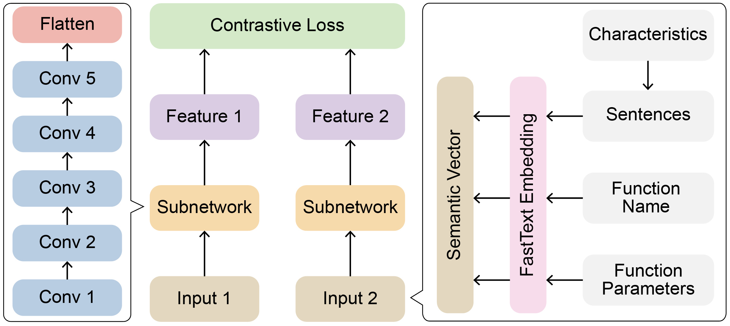
COMANTICS
Which one is correct?
Data Processing
Transformation candidates: T₂ , T₆ , T₁₇ , T₂₁
Input
Generate Tables
Detect Characteristics
Siamese CNN model
Type Inference
Characteristic-Based
CNN-Based
Parameter Inference
Please refer to the paper for details.
Transformation likelihood: T₆ > T₂ > T₂₁ > T₁₇
Notes:
Here is the architecture of the model.
Besides table changes, we find the semantics of a transformation can be implied in the code, so we <click> take the characteristics, the function name, and its function parameters as input to the model.
<click> Please refer to our paper for details.
The third step aims to infer parameters for transformations.

Slide 36
COMANTICS
Which one is correct?
Data Processing
Transformation likelihood: T₆ > T₂ > T₂₁ > T₁₇
Generate Tables
Detect Characteristics
T₆
T₂
T₂₁
T₁₇
P1:
P2:
P3:
P4:
P1:
P2:
P3:
P1:
P2:
P3:
P4:
P5:
P1:
P2:
P3:
P4:
slot
Type Inference
Characteristic-Based
CNN-Based
Transformation type: T₂
Parameter Inference
Parameters: {
P1: xxx ,
P2: xxx ,
P3: xxx
}
Slot Filling
Notes:
The third step aims to infer parameters for transformations.
We first <click> define a set of parameters, namely, <click> slots, for each transformation.
Then we detect these parameters, that is, <click> filling slots, based on the wrangling code, table changes, and input/output tables.
Finally, <click> we obtain the semantics of a line of wrangling code.

Slide 37
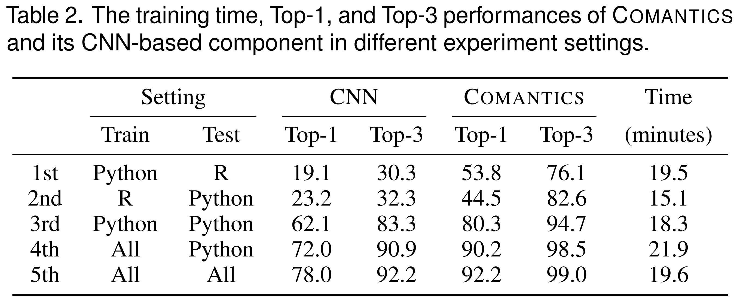
Experiments
Two aspects of evaluation:
How each part of COMANTICS contributes to the overall performance
How well can COMANTICS generalize to different programming languages
Dataset
606 lines of Python code
315 lines of R code
Results
Notes:
To evaluate the performance and the generalizability of COMANTICS, we designed five sets of experiments on our collected dataset.
The results show that COMANTICS achieves <click> more than ninety percent (90%) Top-1 accuracy.

Slide 38
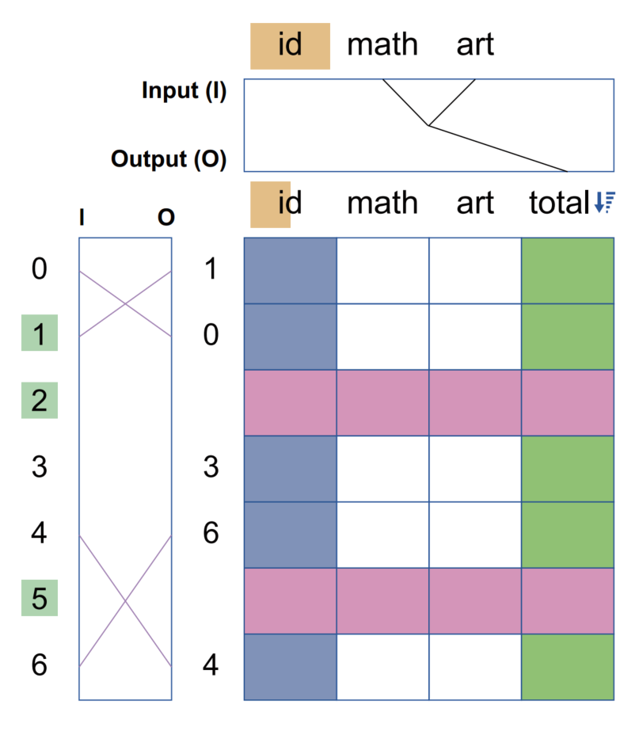
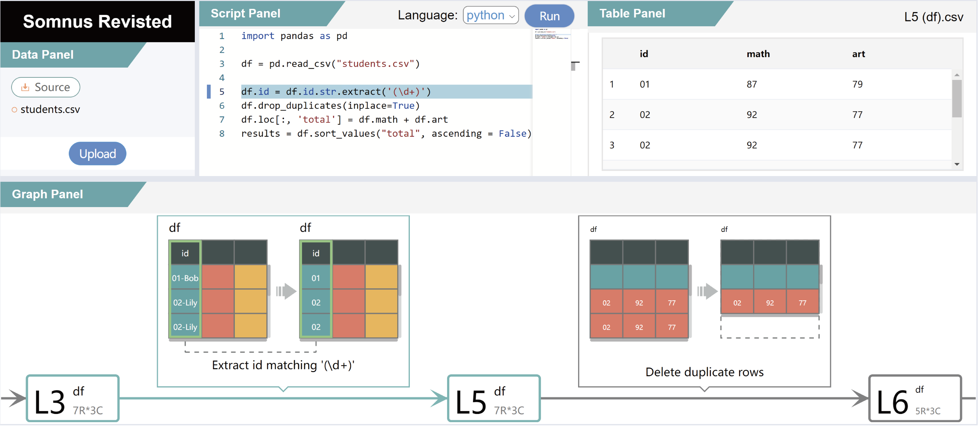
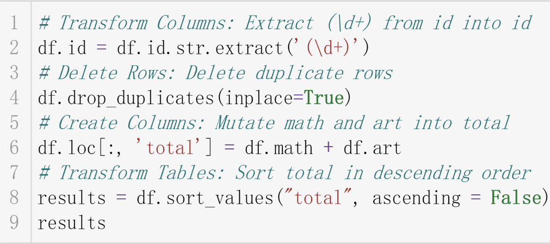
Example Applications
Code Annotation
Semantics Visualization
Table Comparison
Notes:
Moreover, to evaluate the flexibility of our pipeline, <click> we apply it to three applications in different domains.
Let's see the first two applications with a video.

Slide 39
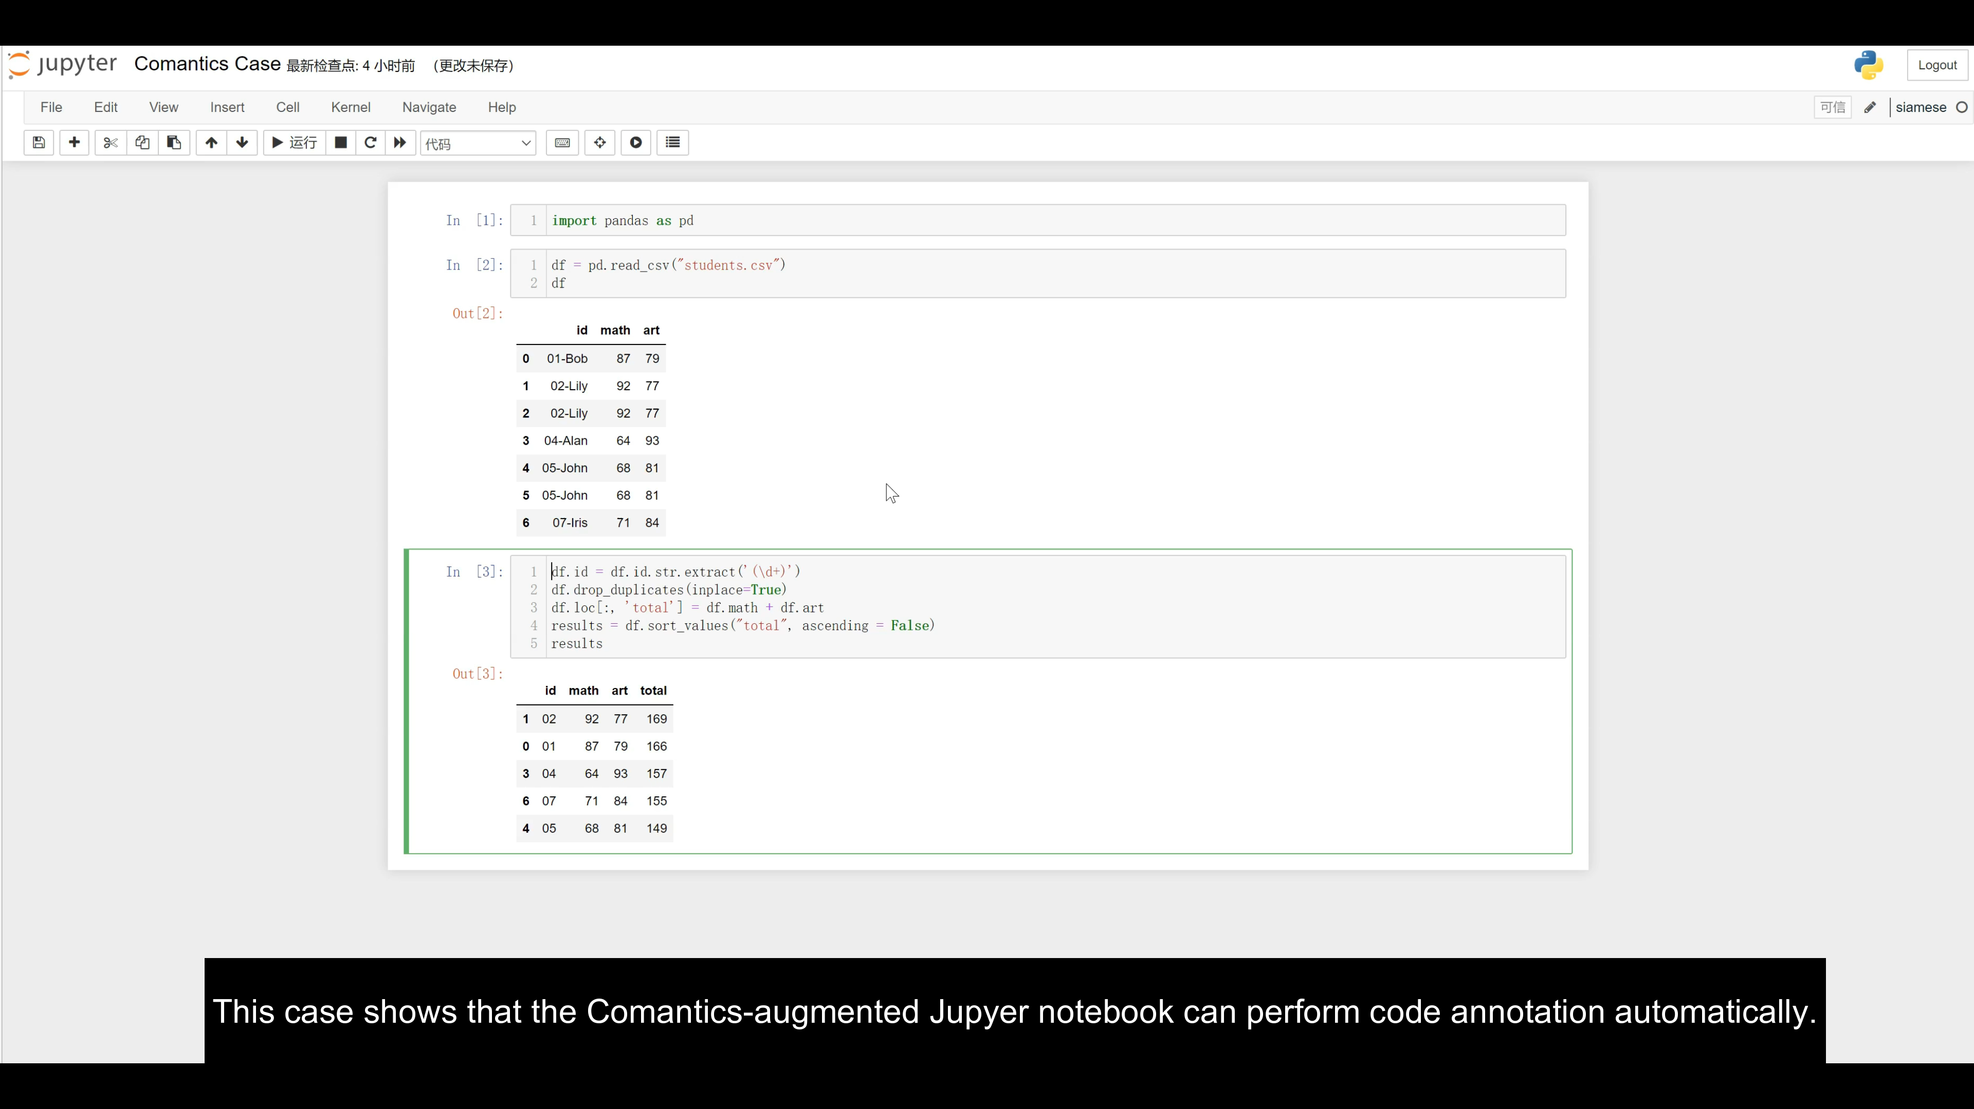
Notes:
This first case shows that the COMANTICS-augmented Jupyter notebook can perform code annotation automatically.
In the second case, COMANTICS can help SOMNUS to support statements that are not supported in the previous version.

Slide 40


Conclusion
Contributions
summarize a design space including 103 characteristics of table changes
construct COMANTICS, a novel pipeline for inferring semantics of data wrangling scripts
build a real-world dataset including 921 lines of wrangling code where each is annotated with a data transformation
perform quantitative experiments to evaluate the performance of COMANTICS
apply COMANTICS to three applications in different domains
Future Work
improve the performance of COMANTICS by refining the Data Preprocessing step and Type Inference module
enhance the capability to meet the need for production usage
incorporate COMANTICS in a broad range of applications, including spreadsheet software, data wrangling tool, and source-to-source compiler
Notes:
In summary, our main contributions include a design space for table changes and a pipeline for inferring semantics.
In the future, we plan to improve the performance of COMANTICS, enhance its capability, and incorporate it into different applications.

Slide 41
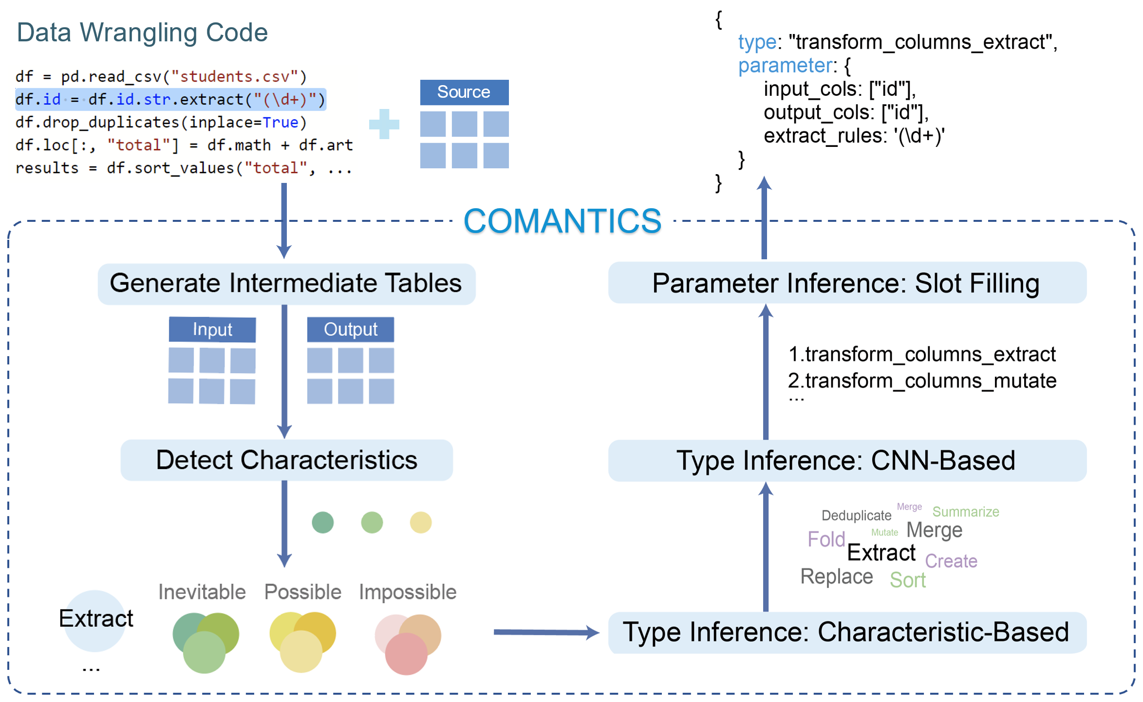
Revealing the Semantics of Data Wrangling Scripts With COMANTICS
Kai Xiong, Zhongsu Luo, Siwei Fu, Yongheng Wang, Mingliang Xu, Yingcai Wu
COMANTICS
Thank You!
SOMNUS
IEEE TVCG 2022
IEEE VIS 2022
E-mail: kaixiong@zju.edu.cn
Notes:
That concludes my presentation. I'm ready to take questions, thank you.

